Slide 1
Final Engagement
Attack, Defense & Analysis of a Vulnerable Network

Slide 2
Table of Contents
This document contains the following resources:
Network Topology & Critical Vulnerabilities
Alerts Implemented
Hardening
Implementing Patches

Slide 3

Network Topology
& Critical Vulnerabilities
3

Slide 4
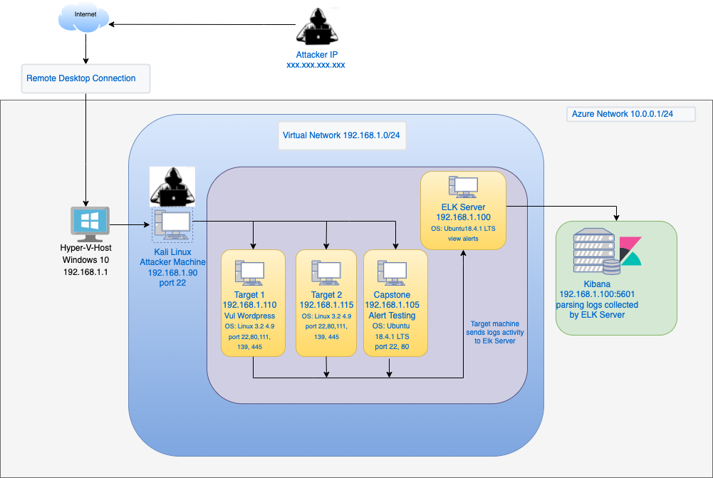
Network Topology
Network
Address Range:192.168.1.0/24
Netmask:255.255.255.0
Gateway:192.168.1.1
Machines
IPv4:192.168.1.90
OS: Linux
Hostname: Kali
IPv4: 192.168.1.100
OS: Linux
Hostname: ELK
IPv4: 192.168.1.105
OS: Linux
Hostname: Capstone
IPv4:192.168.1.110
OS: Linux
Hostname: Target1

Slide 5
Critical Vulnerabilities: Target 1
Our assessment uncovered the following critical vulnerabilities in Target 1.
Vulnerability | Description | Impact
Open Port and Service discovery | Nmap was used to find the open ports | The attacker could get access to active services.
User Enumeration WordPress site | WPscan was used to get username information and hidden web files (wp-config.php) | Username info was used by attacker to gain access to the web server.
Weak User’s Password | A user (michael) had a weak password and attacker could crack it by guessing. | Attacker could SSH into the web server
MySQL Data Exfiltration | By traversing through the databases and tables, the attacker got password hashes for all the users. | The attacker was able to crack down the password hashes using John the Ripper.

Slide 6
Critical Vulnerabilities: Target 2
Our assessment uncovered the following critical vulnerabilities in Target 2.
Vulnerability | Description | Impact

Slide 7
Alerts Implemented
7

Slide 8
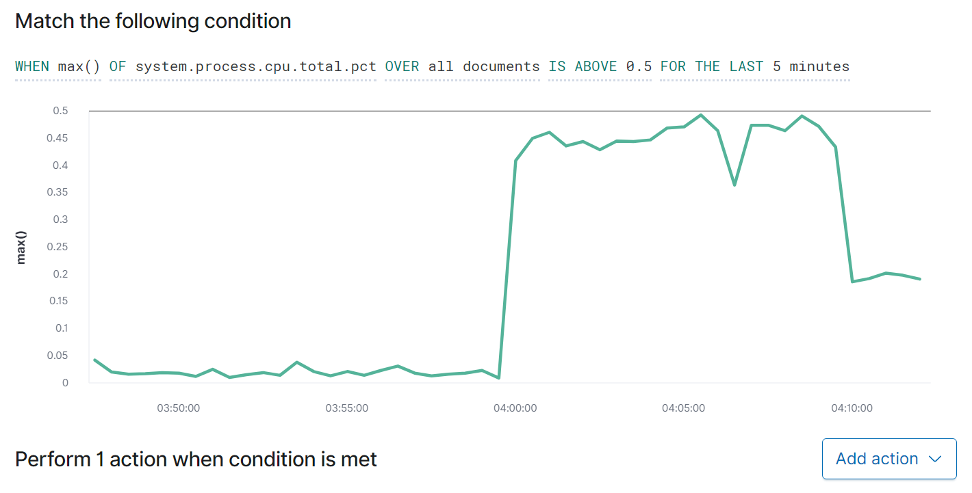
[CPU Monitor]
Summarize the following:
Which metric does this alert monitor? CPU Usage Monitor
What is the threshold it fires at? Threshold triggers at resource use above 0.5.
Provide a screenshot of the alert in action.

Slide 9
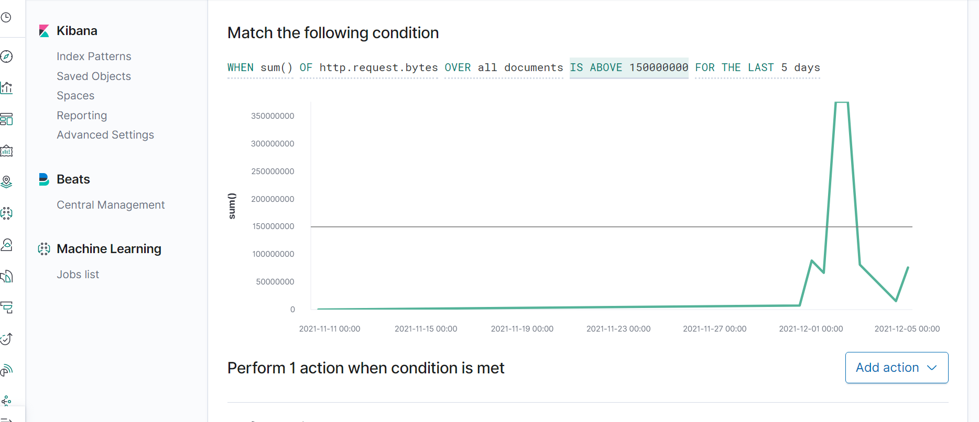
[HTTP Request Size Monitor]
Summarize the following:
Which metric does this alert monitor? HTTP Bytes Size
What is the threshold it fires at? Threshold triggers at 150000000
Provide a screenshot of the alert in action.

Slide 10
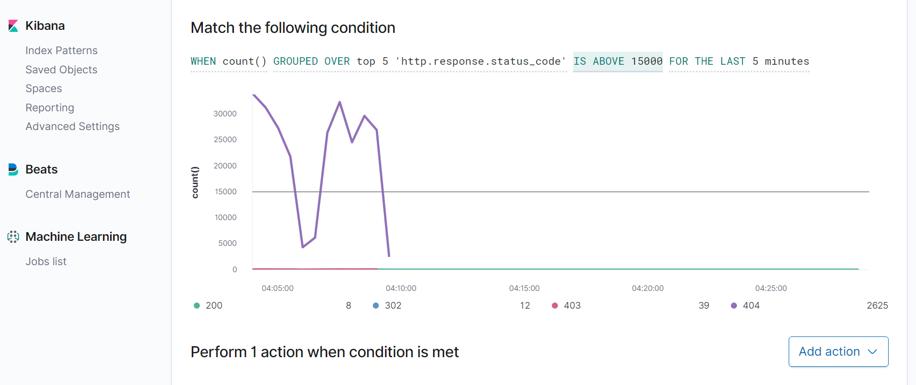
[Excessive HTTP Errors]
Summarize the following:
Which metric does this alert monitor? HTTP Errors
What is the threshold it fires at? Threshold triggers at 15000 http errors returned
Provide a screenshot of the alert in action.

Slide 11
Hardening
11

Slide 12
Hardening Against [Open Ports & Services ] on Target 1
Why the patch works. Close or Filter the Ports
How to install it (include commands)
This command blocks other ports but leaves 80 and 443 open.
iptables -A INPUT -p tcp -m tcp -m multiport ! --dports 80,443 -j DROP.
It good to implement and configure Host Based Intrusion Detection System (HIDS) to monitor computing systems.

Slide 13
Hardening Against [Hidden URL Directory] on Target 1
Hide server in air gap environment to prevent remote connection
How to install it (include commands) If you air gap it’s a physical security measure.
Harden server against code injection and DDOS
Implement HTTP Requests Limit on the web server.

Slide 14
Hardening Against [Brute Force 3] on Target 1
Add rules like blocking specific IP addresses. Use 2-factor authentication.
Limit failed login attempts.
Monitor server logs.
Make the root user inaccessible via SSH by editing the sshd_config file.
How to install it (include commands)
sudo systemctl status firewalld
sudo firewall-cmd --permanent --add-rich-rule="rule family='ipv4' source address=‘192.168.1.90' reject“

Slide 15
Hardening Against [SQL Data Exfiltration1] on Target 2
Why the patch works. Add modules to sanitize inputs.
Set the capabilities of the database users to the bare minimum required.
Encrypt private/confidential data being stored in the database.
How to install it (include commands).
<?php
function sanitize($stringToSanitize) {
return addslashes(htmlspecialchars($stringToSanitize));
}
// You can just use the codes themselves instead of creating a function as:
echo addslashes(htmlspecialchars($stringToSanitize));

